Slide 1
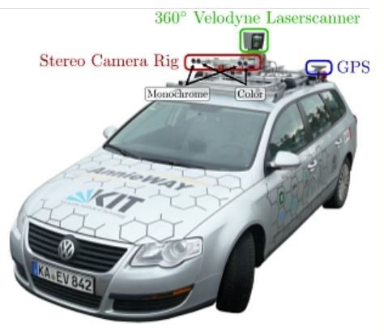
Monocular Depth Estimation for Vehicles

Slide 2
MEET THE TEAM AND ROLES TEAM NAME : ADVANCED TECH(TEAM-236) M.HARSHITHA REDDY Implementation with proper documentation and Research T.TEENA Dataset collection and Data pre-processing S.VINAYA SRI Designing and Research CH.SIRI MEGHANA Dataset collection and Datamodel implementation D.GEETHIKA Designing and implementation with proper documentation R.TRINAYA Dataset collection and Research
Notes:
Monocular depth estimation is a computer vision technique that estimates the distance of objects from a single image. In the automotive industry, this technology has gained significant importance for various applications.

Slide 3
PROBLEM STATEMENT
The purpose of this project is to design and implement a monocular deep learning-based system that can detect potholes, speed breakers, and vehicles present at a certain distance using a camera mounted on a vehicle.
Notes:
Monocular depth estimation leverages deep learning algorithms and neural networks to predict the depth information from 2D images. These networks are trained on large datasets of images and corresponding depth maps to learn the relationships between objects and their depths.

Slide 4
WHY THE PROBLEM OCCURS Distracted Driving: Distracted driving is one of the leading causes of road accidents. It includes activities such as using mobile phones, texting, adjusting the radio, eating, or engaging in other tasks that divert the driver's attention from the road. Speeding: Driving at excessive speeds significantly increases the likelihood of accidents and the severity of their consequences. Unseen Obstacles: Drivers may fail to detect debris, potholes, or other obstacles on the road, leading to accidents or damage to the vehicle. Reduced Visibility: Poor weather conditions, such as heavy rain, fog, or darkness, can reduce visibility, leading to accidents if drivers overlook potential hazards.
Notes:
Monocular depth estimation has numerous applications in the automotive industry, including: - Autonomous Driving: Depth estimation helps vehicles perceive their surroundings and make informed decisions. - Collision Avoidance: It enables vehicles to detect and avoid obstacles in real-time.

Slide 5
THE SOLUTION Dataset details:To create a dataset for monocular depth estimation and object detection, you will need a combination of RGB images, corresponding depth maps, and annotations for potholes, speed breakers, and vehicles. Gathering a diverse dataset from real-world scenarios can be challenging and may require significant effort. THE FOLLOWING STEPS WERE DONE TO SOLVE THE PROBLEM: Data Preparation: Preprocess the dataset by resizing images to the appropriate input size for the monocular depth estimation and object detection models. Normalize the pixel values and ensure that the depth maps are aligned with the RGB images. DepthEstimationModel:Train a deep learning model (e.g., U-Net or ResNet) on the dataset to predict depth maps from RGB images. Minimize the difference between predicted depth maps and ground truth using mean squared error, enabling the model to estimate accurate 3D distances from 2D images.
Notes:
Monocular depth estimation is a cutting-edge technology that holds immense potential in revolutionizing the automotive industry. As research continues, we can expect even more accurate and efficient depth estimation techniques for safer and smarter vehicles.

Slide 6
Object Detection Model:Build an object detection model using YOLO or Faster R-CNN to detect and classify potholes, speed breakers, and vehicles in the scene. Train the model on the annotated dataset to accurately identify objects of interest, enabling the system to warn the driver of potential hazards.
Testing and Evaluation: Thoroughly test and evaluate the entire system using real-world driving scenarios and various challenging conditions. Validate the accuracy and robustness of the depth estimation and object detection models. Ensure that the alerting system performs as expected and provides timely and accurate warnings to the driver.

Slide 7
FUTURE WORK
Real-world Deployment and Testing: Conduct extensive real-world testing and deploy the system in a diverse range of driving scenarios to evaluate its performance, robustness, and reliability. Gather feedback from real users to identify areas for improvement.
Multi-Modal Sensing: Investigate the use of multiple sensors, such as LiDAR or radar, in addition to the monocular camera, to improve depth estimation accuracy and provide redundancy in hazard detection.
Multi-Camera Fusion: Explore the fusion of data from multiple cameras mounted on different sides of the vehicle to provide a more comprehensive view of the surroundings and improve the accuracy of object detection and depth estimation.
Dynamic Speed Control: Extend the system to automatically adjust the vehicle's speed based on detected objects and their distances, further enhancing safety and preventing accidents.
Future work should focus on addressing the limitations of the current system, fine-tuning model parameters, and continuously refining the system based on real-world performance and user feedback to ensure its effectiveness in preventing accidents and enhancing driving safety.

Slide 8
THE CONCLUSION

Slide 9
THANK YOU

